Slide 1
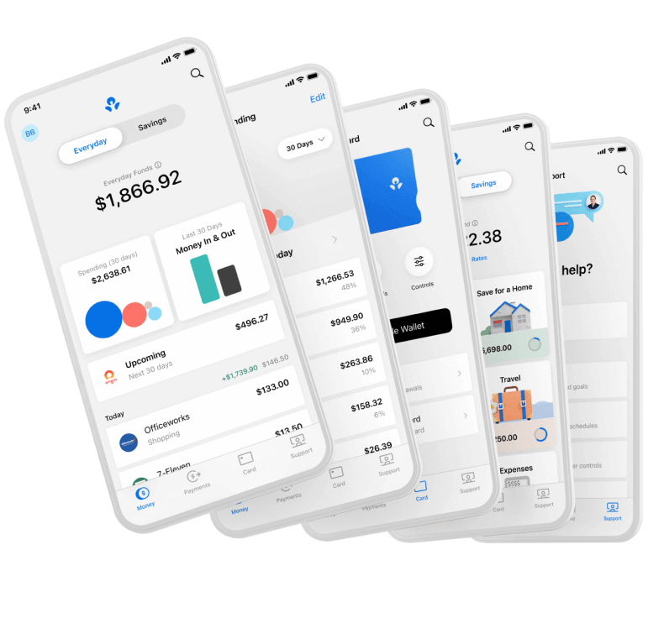


Lessons Learned Running GKE Clusters on Spot Instances
Olga Mirensky, Platform Engineer, ANZx
Notes:
Digital transformation program
new digital bank from scratch
cloud native stack, public clouds and implementing SRE practices latest and greatest tech and exciting stage of the product
Prior to ANZx k8s distro

Slide 2
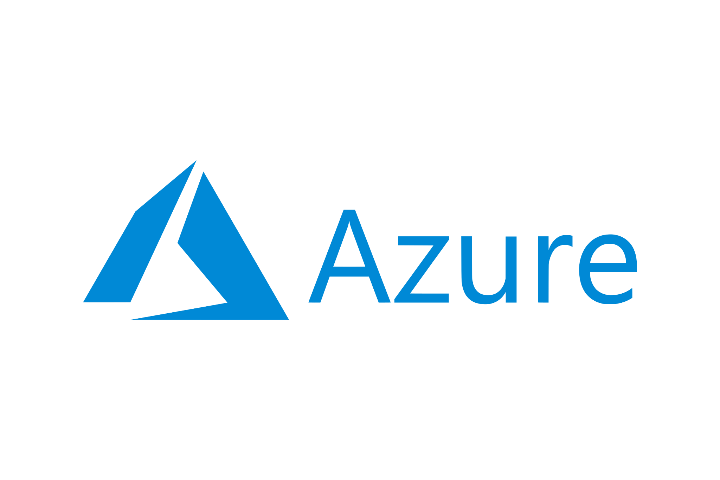


Spot Instances Quick Overview
Discount | 60 - 91% | Up to 90% | Up to 90%
Updates | Once a month | Can be frequent | Variable
Options | One size fits all | Price and/or capacity optimised | Set max price
Notice | 30 sec | 2 min | 30 sec
On preemption | Stop/Hibernate | Stop/Hibernate/Terminate | Deallocate/Delete
Price Insights | API, Cost table | `aws ec2 describe-spot-price-history` Spot instance advisor | Portal price/eviction history, API
Notes:
Provisioning model of compute Resources excess
Heavy discounts, no availability guarantee short preemption
Price fluctuates
ANZ Plus launched last year, production spend was not a major concern but non-production massive beast
In non prod we have multiple environments with few tiers in each.
in these clusters we could tolerate some instability so we decided to explore spot instances to reduce our cloud spend.

Slide 3
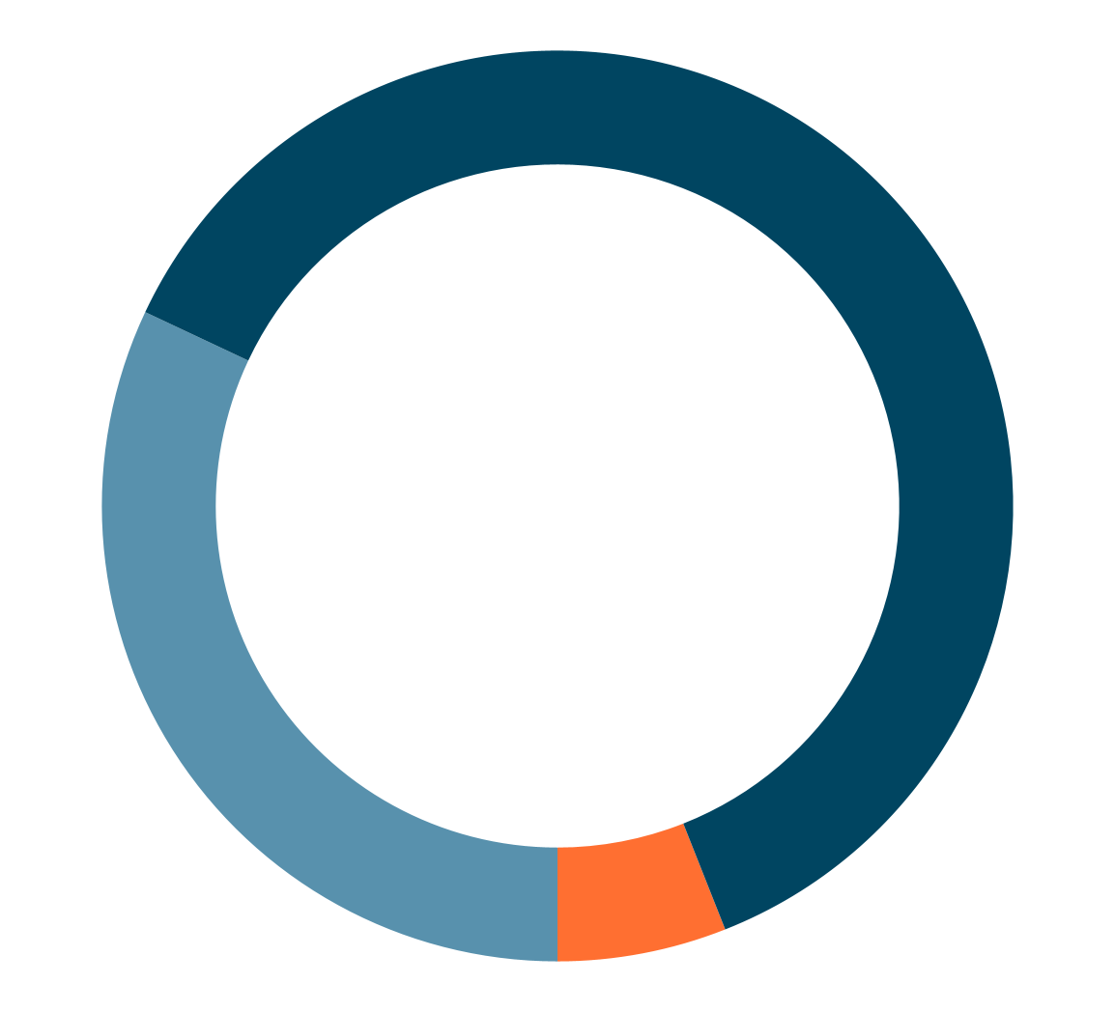
This Talk Scope
Capacity Availability
Importance
Graceful Termination
huh?..
Most of today’s talk
Disclaimer: This pie chart is a work of fiction. Any resemblance to actual stats is purely coincidental.
Notes:
For today’s talk scope, We will only very briefly talk about the two main concerns
very well understood well known patterns, OSS and managed solutions
Instead in the little time that I have today I want to share some unexpected things we’ve learned on our journey - the unknown unknown.
Can be different.

Slide 4
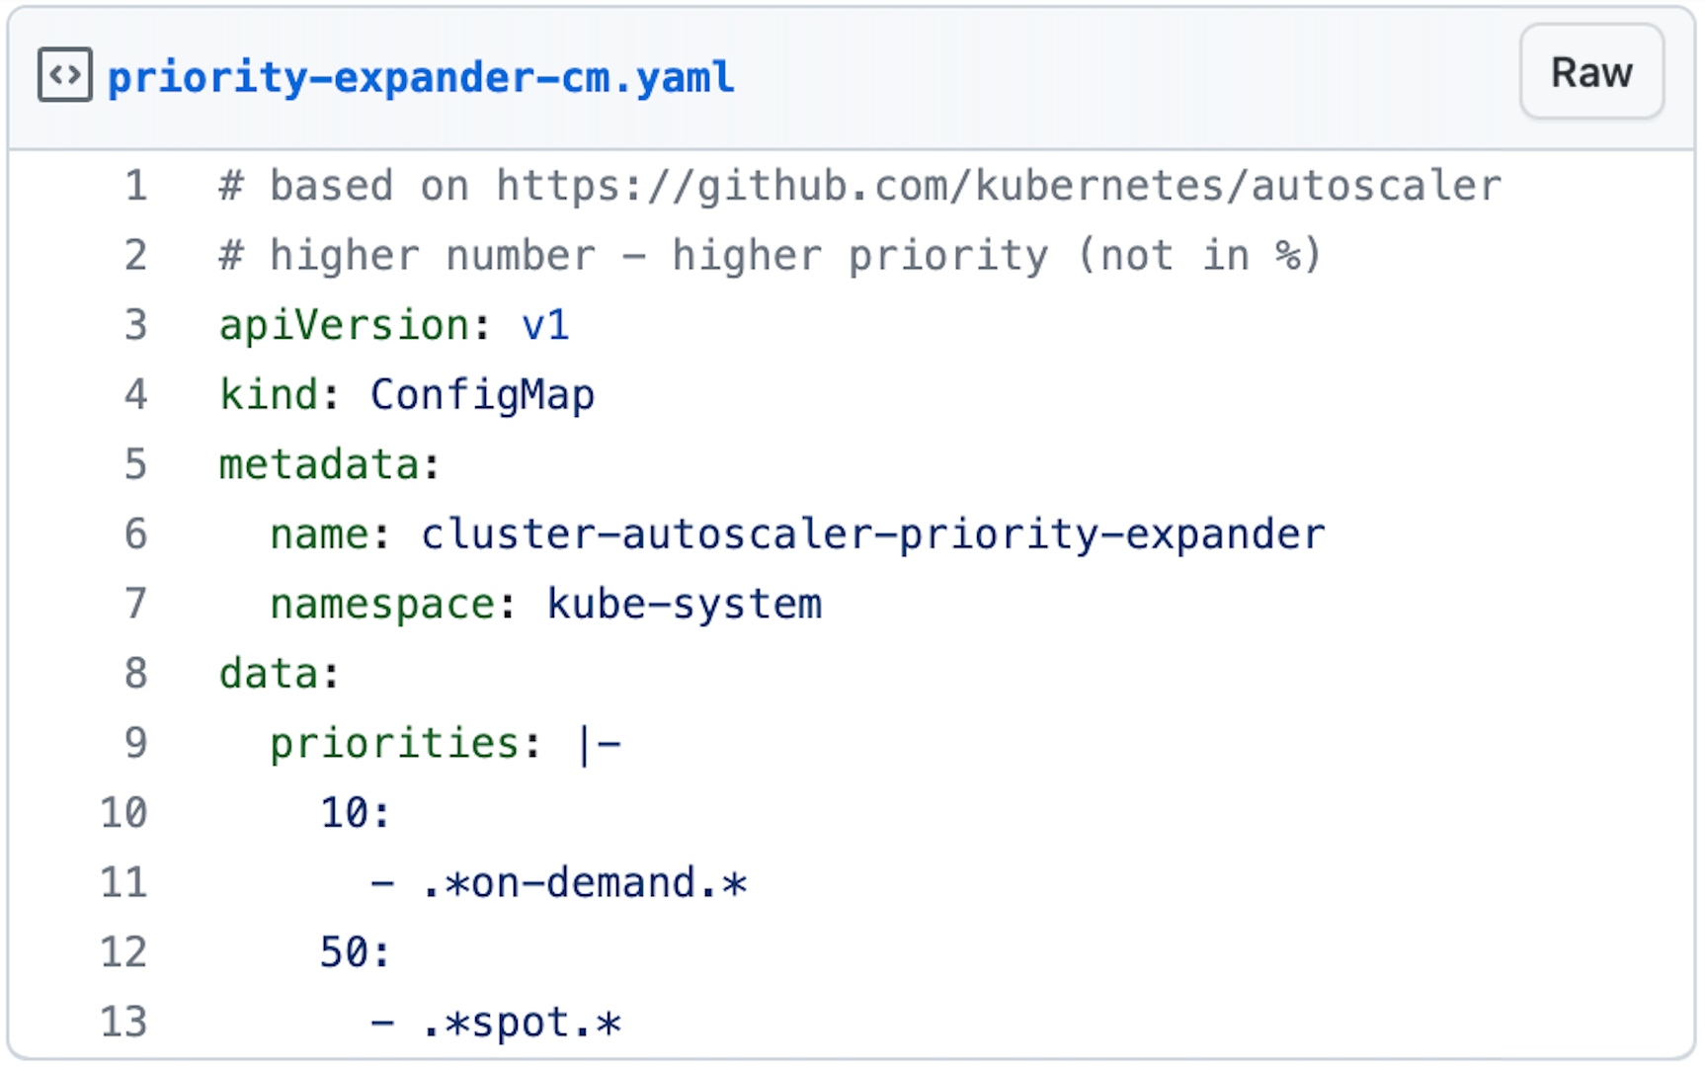
Spot Capacity Management in Kubernetes
Fallback to on-demand automatically (and un-fallback)
Priority based expander for Cluster Auto Scaler
GKE Cluster Auto Scaler price-optimised by default
Weighted NodeAffinity
Cluster Reserved Capacity
Cluster Auto Scaler config option
Headroom / balloon pods
Managed Dataplane
Spot by NetApp, etc.
Service quota limit for Spot CPU
Notes:
Mix of spot and on-demand requirements and constraints
Profile: Balanced Optimized-utliisation
Managed dataplane for k8s employs Machine Learning and predictive algorithms proactively replace VMs. Enterprise SLA

Slide 5
Graceful Shutdown
Fault tolerant applications
Graceful shutdown on SIGTERM
In-flight requests handled
New requests not routed and not accepted
External connections are closed (DB)
App specific requirements
Node Graceful Shutdown feature in k8s
Enabled by default since 1.21
Node NotReady
SIGTERM propagation: workload vs system pods
System Pods
Workload Pods
25 sec
5 sec
Notes:
Interactive webservers
Stateless
Batch processing

Slide 6
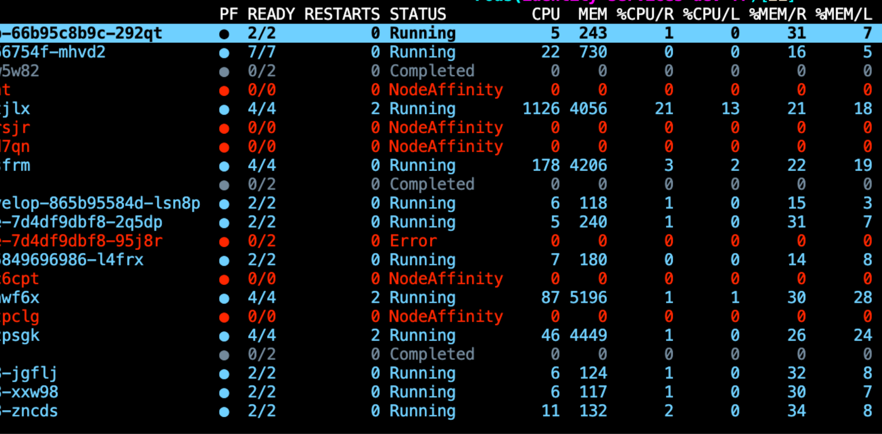
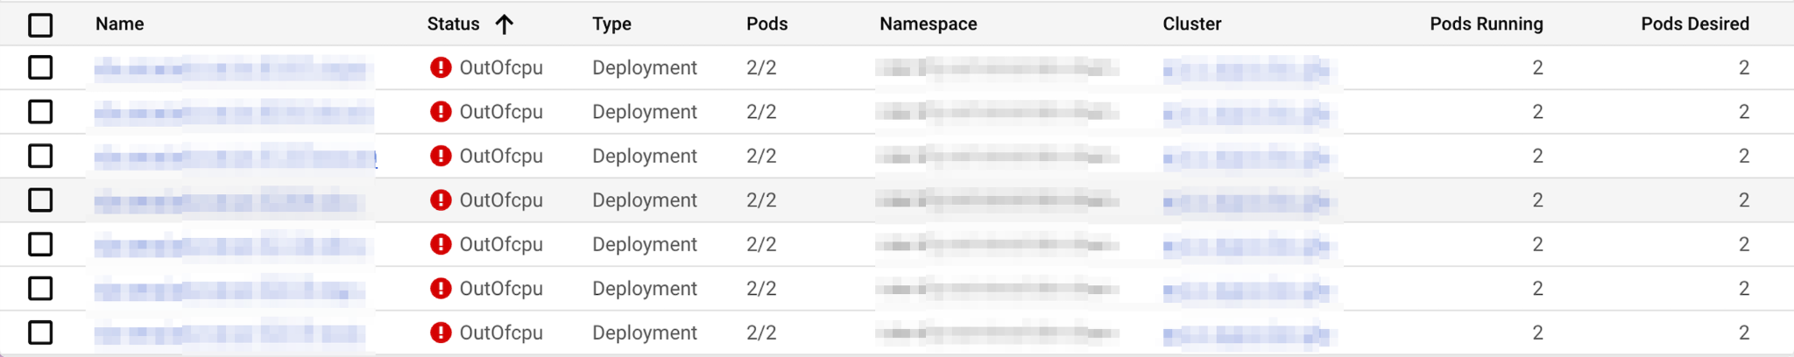
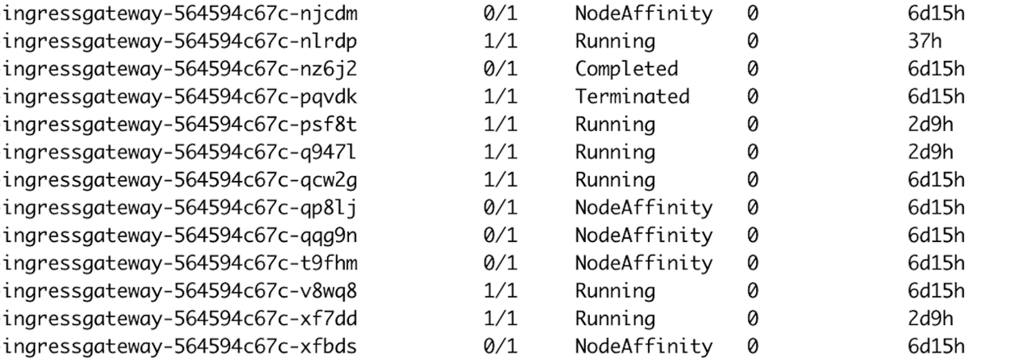
We broke everything (but not really)
⁉️
OutOfpods, Error, NotReady, ContainerStatusUknown, NodeShutdown, Terminated, Init:ContainerStatusUnknown and more!! 😵‍💫
🤔
Notes:
After the switch we started to see a lot of pods in erroring state. I think the main 2 pain points about this is: 1. The overwhelming amounts of these pods
2. The confusing way in which they are presented
Pod status field will have 3 things:
Message, Phase and Reason. The status is “made up” and only exists when you describe pod.
Pod was terminated in response to imminent node shutdown

Slide 7
message: Pod Predicate NodeAffinity failed
Warning FailedMount 2m21s (x3870 over 5d10h) kubelet MountVolume.SetUp failed for volume “xxxx” : object “<namespace>“/”<name>” not registered
Warning FailedMount 45m (x185 over 6h45m) kubelet MountVolume.SetUp failed for volume . kube-api-access-12345" : object "my-ns"/"kube-root-ca.crt" not registered
Warning NodeAffinity 41m kubelet Predicate NodeAffinity failed
Warning FailedMount 26s (x28 over 41m) kubelet MountVolume.SetUp failed for volume . kube-api-access-12345" : object "my-ns"/"kube-root-ca.crt" not registered
Notes:
I am not English speaker, not a lawyer - collection of words I don’t understand
Events tell a better story??
CM exists
Fresh timestamp
This one is even worse because it refers to a config map that is created automatically by k8s

Slide 8
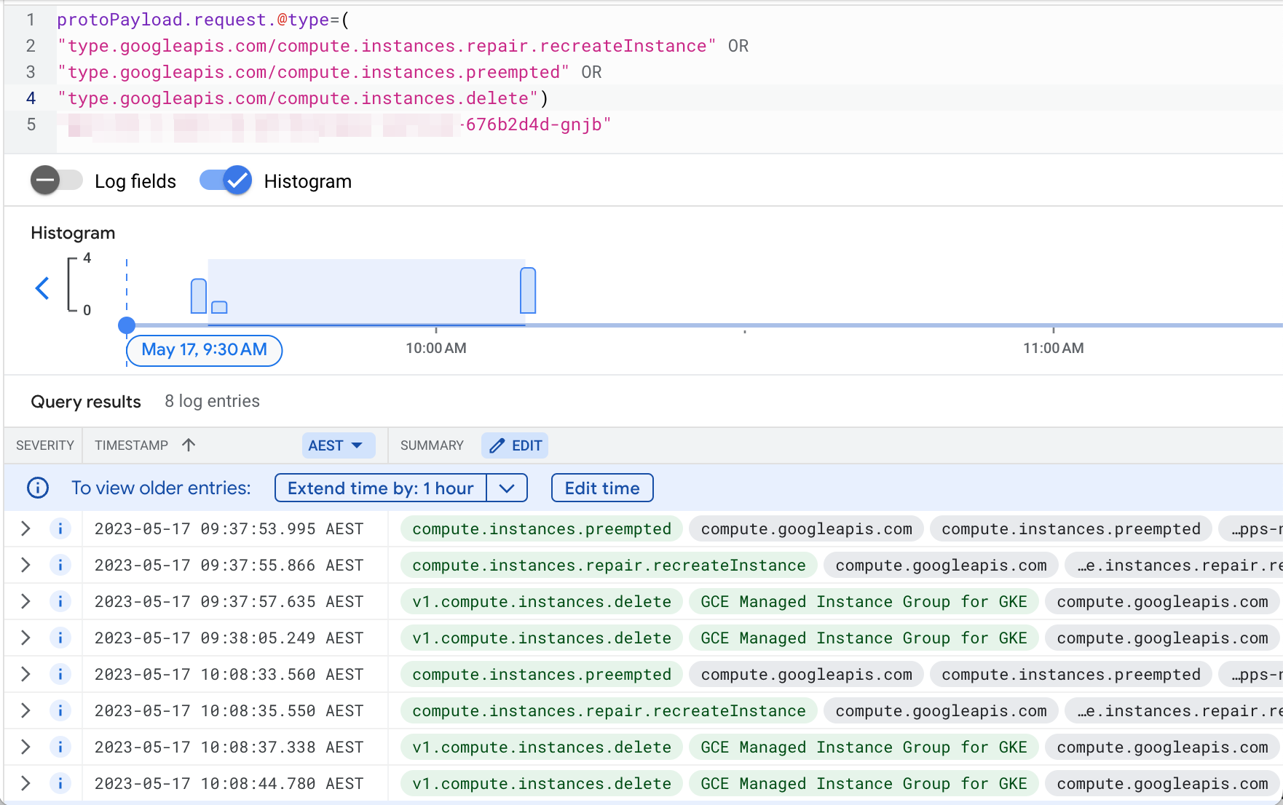
Automatic Reclaiming
The same node can be backed by
different VMs over its lifetime
recreateInstance
method
identity
Notes:
I don’t have time for suspense
Underlying VMs are managed in MIG
When it detects a signal that VM is preempted it MUST remove the instance from its group non negotiable
When it succeeds the node will remain in the cluster for all intents and purposes
from k8s perspective it is the same node with the same name

Slide 9
NodeAffinity
NodeAffinity pods traced back to a node with reclaimed VM and still in cluster
Related to https://issuetracker.google.com/issues/185362914
Kubelet restart edge case
Still an issue with GKE preemptible VMs at the time.
Users still report this issue (1.24.10-gke.2300)
“Note that this issue has little to no impact on workloads. As long as the pod is backed by controller (deployment/statefulset, etc) a new pod is immediately created and rescheduled.”
$ kubectl get pod $name -o yaml … status:
message: Pod Predicate NodeAffinity failed
phase: Failed
reason: NodeAffinity
Notes:
This issue tracker confirms NodeAffinity are linked to kubelet restart edge case
And that while the bulk of this issue was resolved with Node Graceful Shutdown
Previous generation with the same features as Spot
Max lifetime 24h

Slide 10
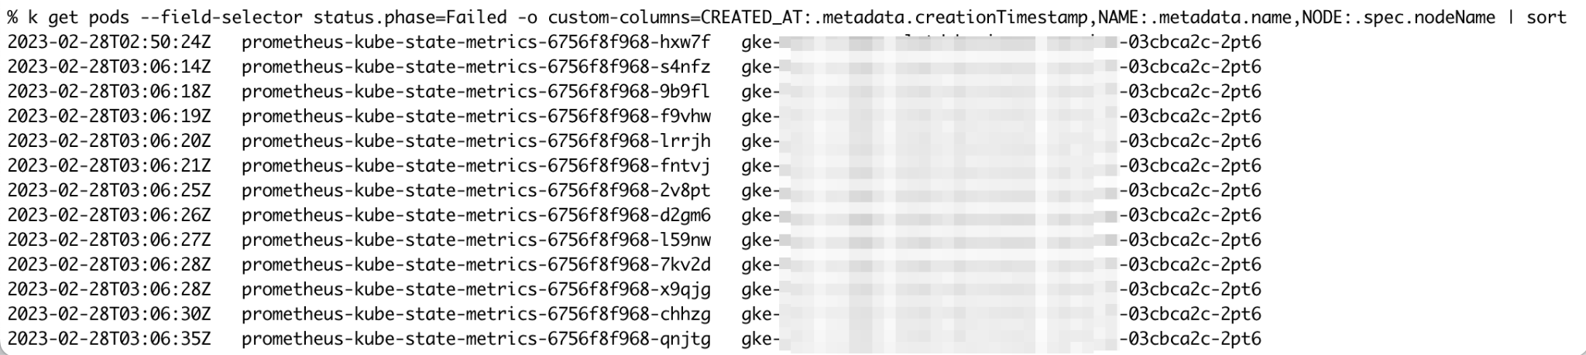
Little to no impact on workloads…
12 pods in 21 seconds on the same node
At least 21 seconds deployment did not have desired capacity
It is not a problem now, but something happened in the past
Notes:
Scheduler central component kubelet - distributed component
Even worse than that - during this time this pod wasn’t even a candidate for the cluster scale up
https://github.com/prometheus-operator/kube-prometheus/blob/main/manifests/kubeStateMetrics-deployment.yaml#L12

Slide 11
No Panic!
Does my Deployment (StatefulSet / DaemonSet) have desired number of replicas Running and Ready?
But there is a better way…

Slide 12
Not so “little impact”
Platform should be easy to consume
Software Engineers are not experts in Dead Pods
Engineers raise “issues” and support requests again and again, wastes time
Spot instances became the first suspect when anything goes wrong even when
Technically there is no issue
Or issues are not caused by Spot preemptions
Notes:
If technically this is not an issue, then why are we even bothering? Precisely because *technically* it is not an issue, we on the Platform SRE side
Blissfully unaware of the effects Spot instances had
Developers need a platform that enables productive development and is easy to work with
Depoy complex stacks consisting of multiple deployments
No wonder they would come after us with pitchforks and torches.

Slide 13
Solutions
k8s Garbage Collector
In GKE threshold is 1000 objects
https://github.com/kubernetes-sigs/descheduler
Safely evicts (not deletes) pods
Rebalance Availability Zones
Spread pods of the same deployment across nodes
Remove ‘Failed’ pods immediately, and more
Data
Platform Critical User Journeys (CUJ) and SLOs
Notes:
Helps mitigate concerns that are particularly important in Spot clusters
This is real data, number that harde to argue with
This is your proof that your platform is providing agreed level of service even when running on unreliable infrastructure.
Inspires confidence.

Slide 14
Takeaways
Implementing well-known SRE k8s practices are crucial on Spot:
Replication
Spread across zones and nodes (TSC[1], pod AntiAffinity)
Graceful shutdown
Probes
Tier applications by priority
PDBs. Don’t protect from Spot preemptions, but improve overall availability
[1] new features: https://kubernetes.io/blog/2023/04/17/fine-grained-pod-topology-spread-features-beta/
Notes:
By definition there will be MORE movement in your cluster. The good news is that k8s is designed for dynamic env and failure scenarios and gives a lot of features
You just need to harness this power really really well.
Probes, especially the startup probes. Startup is the flip side of the preemption

Slide 15
What doesn’t kill you makes you stronger
Thank you
CAS expanders: https://github.com/kubernetes/autoscaler/tree/master/cluster-autoscaler/expander
Open Source CAS developed by AWS: https://karpenter.sh/
GKE on-demand fallback: https://cloud.google.com/blog/topics/developers-practitioners/running-gke-application-spot-nodes-demand-nodes-fallback
TopologySpreadConstraints new features: https://kubernetes.io/blog/2023/04/17/fine-grained-pod-topology-spread-features-beta/

Slide 16
Resources
CAS expanders: https://github.com/kubernetes/autoscaler/tree/master/cluster-autoscaler/expander
Open Source CAS developed by AWS: https://karpenter.sh/
GKE on-demand fallback: https://cloud.google.com/blog/topics/developers-practitioners/running-gke-application-spot-nodes-demand-nodes-fallback
TopologySpreadConstraints new features: https://kubernetes.io/blog/2023/04/17/fine-grained-pod-topology-spread-features-beta/

